Slide 1
Welcome to our reception class

Slide 2
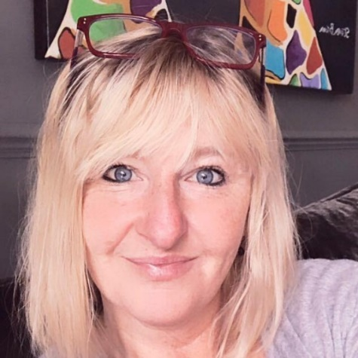
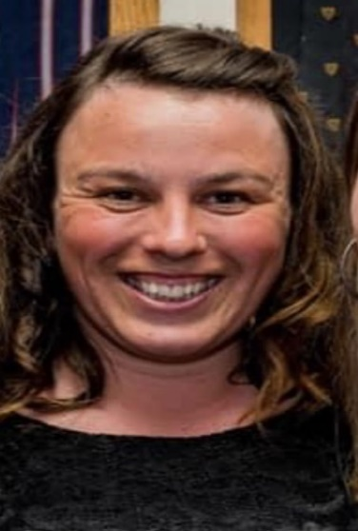
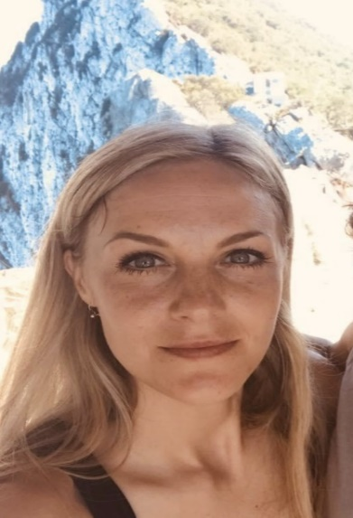
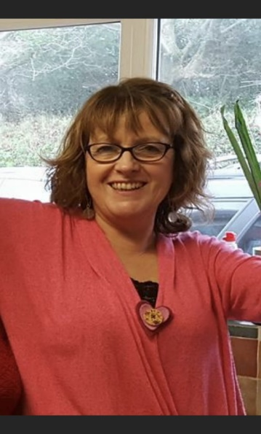
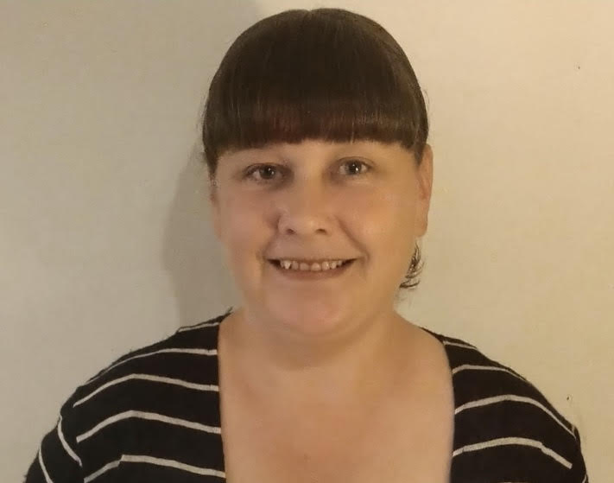
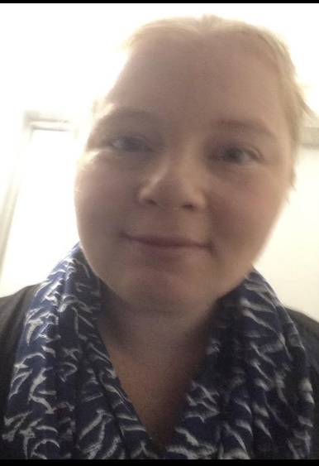
The adults in our class
Mrs Griffiths
EYFS Lead and teacher
Miss Morse
EYFS Teaching Assistant
Miss Lana EYFS Teaching Assistant
Mrs Allen
EYFS Preschool Lead
Mrs Hart
EYFS Preschool Teaching Assistant
Mrs Davis EYFS Teaching Assistant
.

Slide 3
welcome
Staffing
I am Mrs Griffiths, the full time teacher in our Foundation Unit and I am supported by Miss Morse- Monday to Fridays all day, Miss Minkeviciute Monday to Friday mornings and Mrs Davis Monday to Friday afternoons. On Friday afternoons, I have leadership and planning time, this is when Miss Orpwood covers.

Slide 4
welcome
Thank you for choosing to send your child to St Mary’s. We hope they are getting excited about starting their next adventure in learning and coming to school!
Traditionally we offer induction days, but due to certain restrictions this year we are unable to offer this. But we have readjusted our staggered start to ensure all children have plenty of opportunity to feel supported by all adults and get to know us in a friendly and relaxed way!
You will of course be eager to help make starting school as happy an experience as possible and the following pages are intended to give you some useful information.
This booklet suggests some things you could do at home, many of which are familiar, but there is also a section on how we approach reading and writing in school which you might find useful.
Thanks! Mrs Griffiths

Slide 5
welcome
The Reception children follow the Early Years Foundation Stage Curriculum and all Reception children will be assessed on entry, known as a Baseline, this is done informally and within the first three weeks of starting school. Children in our class learn alongside the preschool children, where they shape and lead their own learning and we support and extend their learning through their play. Reception have discrete adult led sessions for phonics and maths.
Children have access to both inside and learning environments which help to support and enhance learning.
As part of the Early Adopters of the new curriculum, our children will cover key areas of learning:-
Prime areas—Communication and Language, Personal, Social, Emotional Development and Physical Development.
Specific areas – Literacy, Mathematics, Understanding the World, Expressive Arts and Design
The children will be continually assessed in these 7 areas throughout their reception year and evidence is collected in their Learning Journey.

Slide 6
School timetable
The school day
Morning routine
Reception come into school through a dedicated side entrance, to the left of the school building. This gate is opened at 8.40am by Mrs Griffiths, who will also be on hand to answer questions. Ordinarily, you are welcome to help your child to settle into their early morning learning activities, however please encourage them to become independent by hanging up their own coats and putting their reading bags into the box on their own. The side gate is locked at 8.50am, and any late children will then enter through the main reception.
Morning Learning
Children are taught phonics (letters and sounds), Literacy and Maths in the mornings. We have daily collective worship every morning, at 9.15am. Morning snacks, ordinarily are found in our self service snack area. However, at the moment we all have snack together. We will serve them a variety of healthy choice snacks around 10.30am (we kindly ask for a small weekly/monthly donation). There is also fresh fruit available daily and milk is made available daily.
Lunch time
At 11.45am the children go into the hall for lunch. At the moment there will only be packed lunches available from Chartwells (see attached menu for the first few weeks)Ordinarily, your child may have a hot lunch or bring a packed lunch from home which is in line with our healthy eating policy. This can be decided on a daily basis in the morning. There is currently no cost for school dinners for children in Reception and KS1,

Slide 7
School timetable
Afternoon
During the afternoon, the learning is more creative and primarily follows the interests of the child. This encourages children to become independent and investigative learners. Children will learn about the world in which we live, arts and design, P.E and R.E. Guided reading sessions will begin to take place in the afternoons later in the year. Copies of the yearly learning cycle are available on our school website.
Reception children will also have a reading book and it is expected that your child will read at least 5 times a week at home, this needs to be recorded in their home work diary.
End of the day
At the end of the school day, children have a daily story, voted for by the children. This is an opportunity to engage with an enriching reading book which is appropriate to their age and helps to build up story language.
Following the transition weeks, school finishes at 3.00 pm. If possible we encourage parents to park on the promenade to help ease congestion around our school premises at the end of the day.

Slide 8
Fred Rogers
“Play is often talked about as if it were a relief to learning
But for children, play is serious. Play really is the work of childhood”

Slide 9
WHAT IS phonics?
’Letters and Sounds’
During daily phonics lessons, the children will learn new sounds (phonemes) and the corresponding grapheme (the way the letter is written). We teach through a multisensory approach, learning a phoneme and associated action, to support the child’s recall. Phonics is the main approach to develop their reading and writing skills in class. Children will use their knowledge of letters and sounds in their reading and writing to decode and encode words. Children will be issued with a phonics book to take home, which contains the common and exception words for the phase they are learning and a phonic sheet for the phonemes learned that week. These are done in a child friendly manner. Do not worry, a reading workshop for Reception parents will be arranged in the autumn Term.

Slide 10
WHAT IS phonics?
Writing
Writing is probably taught rather differently now to how you remember it, and it may even have changed in the time since your first child started school!
Right from the start we value every child’s contribution, and on their first day in school squiggles may be the best they can offer, that is fine. Squiggles are perfectly acceptable, and are encouraged, very soon this will develop into what most of us would recognise as ‘writing’.
In dedicated adult led lessons, sentences are orally constructed and writing is modelled by staff to encourage every child to be a writer. Children are actively encouraged to apply their phonological knowledge into labels, lists and captions, and then sentences. By the end of the Reception year, all children will be writing naturally, independently, and consistently across all areas of the curriculum. All children love to make marks and write and you can help by providing the necessary equipment. Again, it need not be expensive, in fact old envelopes are a wonderful way to get them to ‘write’ letters, bits of card make great shopping lists, and grease-proof paper is ideal for tracing.

Slide 11
What can you do to help?

Slide 12
HOW CAN YOU HELP? First of all, you can encourage your child to hold their pen/pencil correctly; thumb and forefinger gripping the pencil and middle finger supporting, also encourage them to sit at a table or desk. Secondly make it fun! Below are examples of activities that you could do with your child as appropriate to their age and ability: • Air writing (imaginary letters or words in the air) • Writing on a partner’s back (partner feels for the correct pattern in letters or words) • Sand writing (letters or words in sand or loose dirt) • Paint writing (on an easel or outside on fences or playground using water) • Leaf writing (shuffle feet in fallen leaves to make letters or words) • Chalk writing • Tracing letters/words written on paper • Copying letters/words written on paper • Independently translating printed text into handwriting script

Slide 13
Keeping you informed We aim to keep you fully informed about your child’s progress and give you as much help as we can to support your child with learning at home. We have regular parent meetings and share information relating to your child, allowing you to share their learning from home as well. The first of our meetings will be scheduled to be before the first half term. There is a school website which contains other useful information including the school newsletter . The address is www.st-marys-ce-pz.cornwall.sch.uk In addition to this, we have our own closed Facebook page where we share our weekly learning. Please search Stmarys Griffiths and send a message telling us who you are and the name of your child. We are really looking forward to meeting you and your family, and we wish you every happiness and success within our St Mary’s family.

Slide 14
?
Thank you for your time
Remember, if you need to contact me, please use my school email:
agriffiths@st-marys-ce-pz.cornwall.sch.uk

